Slide 1
topicTen
HTML Forms

Slide 2
Learning Objectives
At the end of this chapter the students should be able to:
Understand all the tags used in forms.
Develop a dynamic web page.
Use different type of form effectively.
Creating a website that capable to interact with visitors.

Slide 3
Introduction
A form is simply an area that can contain form fields. Form fields are objects that allow the visitor to enter any kind of information.
For example text boxes, drop-down menus or radio buttons.
When the visitor clicks a submit button, the content of the form is usually sent to a program that runs on the server.
However, there are exceptions. JavaScript is sometimes used to create magic with form fields.
An example could be when turning options in a drop-down menu into normal links.

Slide 4
Forms: CGI-Script
When submitting a form, we need a program that can receive the information and to do something with it.
Such programs are sometimes referred to as CGI programs.
CGI stands for Common Gateway Interface, which is computer latin for a program that translates information

Slide 5
Forms: CGI-Script
This translation is necessary because the server might be a UNIX machine while the visitor might be sending information from a Windows platform.
Windows and UNIX handle information differently - so if there were no CGI, then UNIX machines could only communicate with other UNIX machines.
Besides that, using PHP and ASP is also a good practice (web programming language).

Slide 6
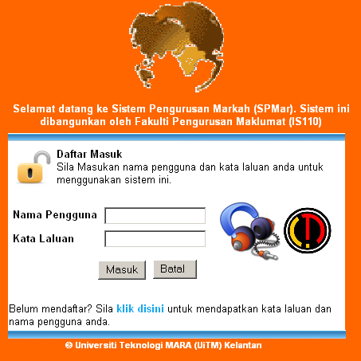
Forms: Example of Login Form
This is what happens when the form is submitted:
The username and password will be sent to server.
The program will search the database for a matching record.
If the record is found, user will be redirected to main page.
If no record is found, an error message will be displayed.

Slide 7
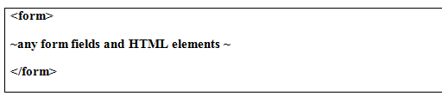
Forms: Tag
When a form is submitted, all fields on the form are being sent.
The <form> tag tells the browser where the form starts and ends.
You can add all kinds of HTML tags between the <form> and </form> tags.
The tags must be included within the BODY section of your HTML pages.

Slide 8
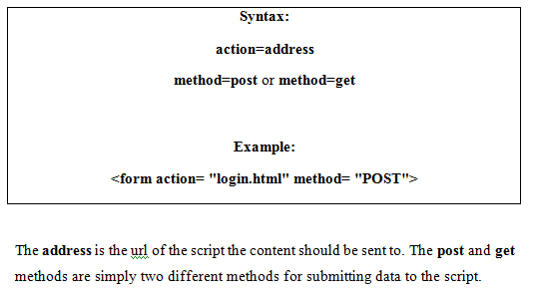
Forms: Tag
This form is useless, because there are no form fields and no recipient that will received the contents of the forms.
This statement is just used to declare that we are using forms in our HTML pages.
To let the browser know where to send the content we add these properties to the <form> tag:

Slide 9
Forms: Fields
Form Fields
Text
Password
Hidden
Textarea
Check Box
Radio Button
Drop-down Menu
Submit Button
Reset Button
Image Button

Slide 10
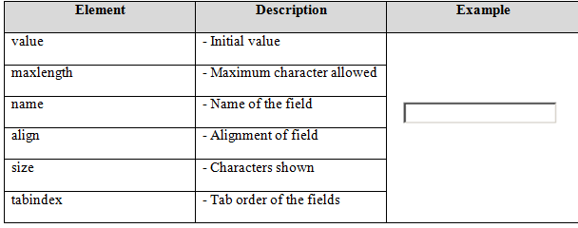
Forms: Text Fields
Text fields are one line areas that allow the user to input text.
<input type= "text" size= "25" name= "username">

Slide 11
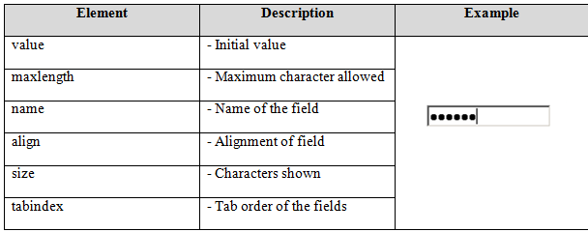
Forms: Password Fields
Password fields are similar to text fields.
The difference is that what is entered into a password field shows up as dots on the screen.
This is, of course, to prevent others from reading the password on the screen.
<input type= "password" size= "25" name= "password">

Slide 12
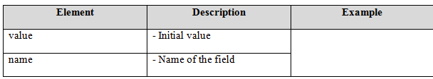
Forms: Hidden Fields
Hidden fields are similar to text fields, with one very important difference.
The difference is that the hidden field does not show on the page.
Therefore the visitor can't type anything into a hidden field, which leads to the purpose of the field which is to submit information that is not entered by the visitor.
<input type= "hidden" size= "25" name= "browser_type">

Slide 13
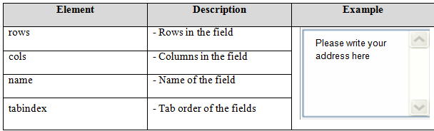
Forms: Text Area
Text areas are text fields that can span several lines.
Unlike most other form fields, text areas are not defined with an <input> tag.
Instead you enter a <textarea> tag where you want the text area to start and a closing </textarea> tag where you want the area to end.
Everything written between these tags will be presented in the text area box.
<textarea cols= "40" rows= "5" name= "address">Please write your address here</textarea>

Slide 14
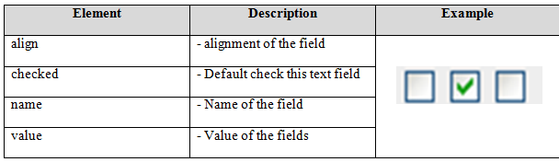
Forms: Check Boxes
Check boxes are used when you want to let the visitor select one or more options from a set of alternatives.
If only one option is to be selected at a time you should use radio buttons instead.
<input type= "checkbox" name= "option1" value= "cash">

Slide 15
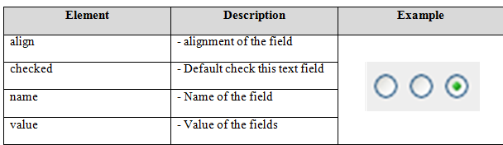
Forms: Radio Buttons
Radio buttons are used when you want to let the visitor select one - and just one - option from a set of alternatives.
If more options are to be allowed at the same time you should use check boxes instead.
<input type= "radio" name= "gender" value= "male">Male
<input type= "radio" name= "gender" value= "female">Female

Slide 16
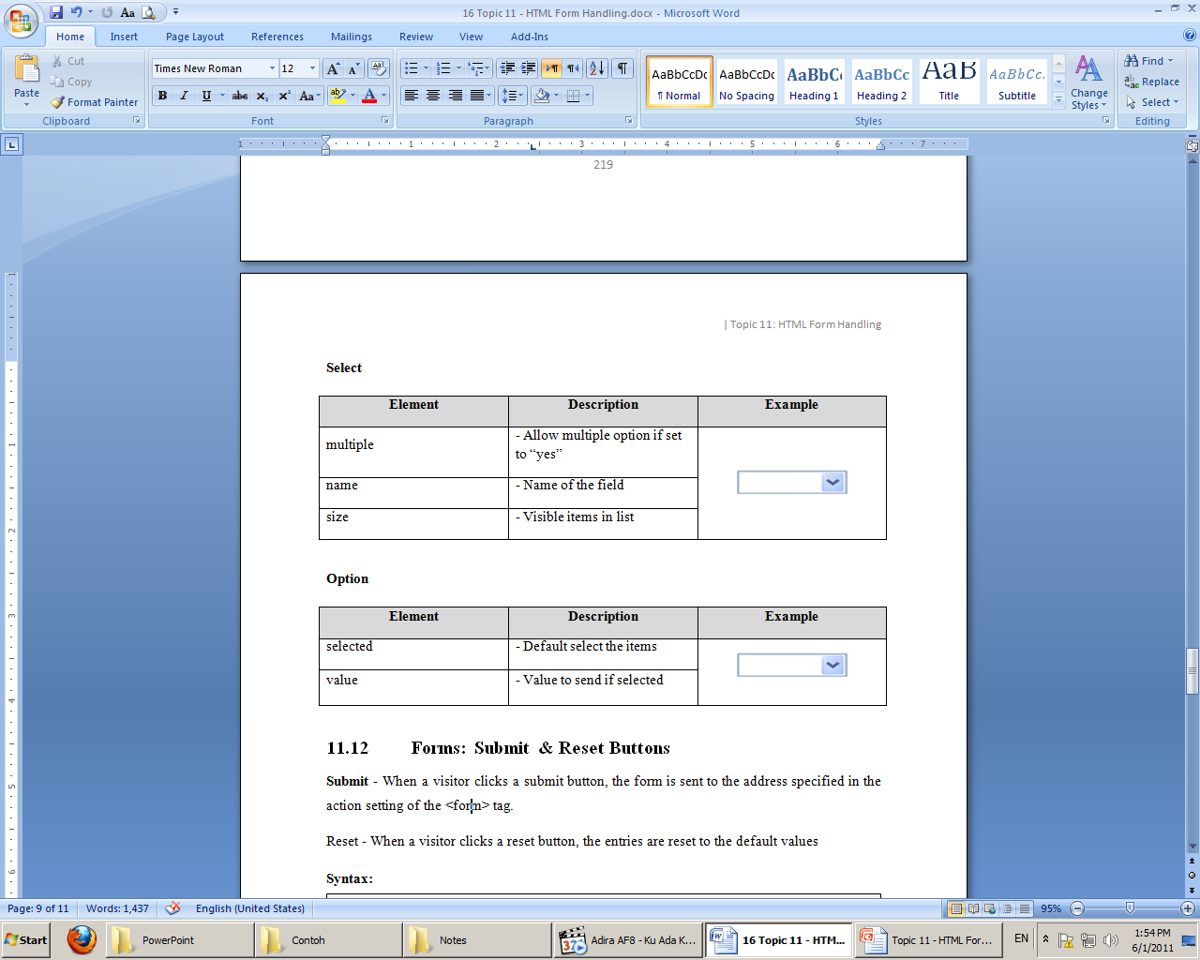
Forms: Drop Down Menu
Sometimes you may want to replace text fields with drop-down menus.
This might be because selecting from a menu is easier than typing.
But it could also be because the script that handles the form can't interpret just any text entry.
<select name= "state">
<option value="Kel">Kelantan</option>
<option value="Ked">Kedah</option>
<option value="Shah">Shah Alam</option>
</select>

Slide 17
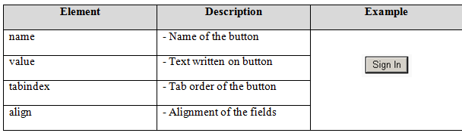
Forms: Submit & Reset Buttons
Submit - When a visitor clicks a submit button, the form is sent to the address specified in the action setting of the <form> tag.
Reset - When a visitor clicks a reset button, the entries are reset to the default values
<input type= "reset" value= "Reset">
<input type= "submit" value= "Submit">

Slide 18
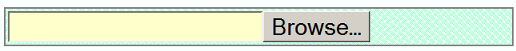
Forms: File
FILE is used for doing file uploads in a form.
File uploads are a relatively new and still not well-standardized type of form input, but they show great promise once the bugs are ironed out.
File uploads allow you to send an entire file from your computer to the web server as part of your form input.
<input type= "file" name= "gambar">

Slide 19
Example: Email Form
<html>
<head></head>
<body>
<form name="form1" method="post" action="mailto:is110@uitm.kelantan.my">
Name: <input name="name" type="text">
Subject: <input name="subject" type="text">
Message: <textarea name="message"></textarea>
<input name="submit" type="submit" value="submit">
</form>
</body>
</html>

Slide 20
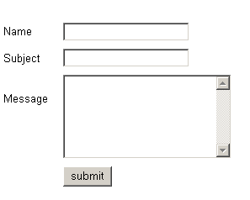

Slide 21
Exercise
Construct HTML codes based on the following statement:
Create HTML codes that request certain information from the visitors. The script should be able to:
Collect name, age, gender, address, campus, mentor and visitor picture.
Information on gender can be inputted using either radio button or drop down list.
Used multiline for address and drop down/radio button for campus and mentor.
Data for campus is Kelantan, Johor, Shah Alam, Sarawak and Kedah.
Data for mentor is En Zulkharnain, En Ghazali, Dr Nasir, En Farouk, En Khalid, En Rashid, En Azhan, En Idzwan, Cik Fatimah, Pn Nor Rahmawati, and Pn Haslinda.
The form should be submitted to an email address which is admin@kelantan.uitm.edu.my using a POST method.

